Slide 1
Linear Algebra

Slide 2

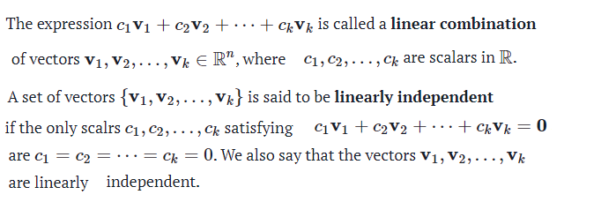


Slide 3
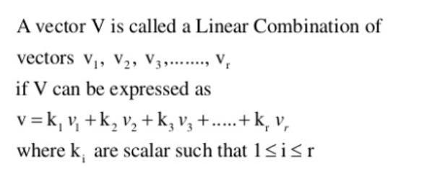
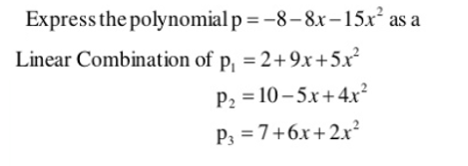
Example 1.

Slide 4

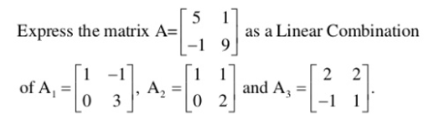
Example 2.
Example 3.

Slide 5
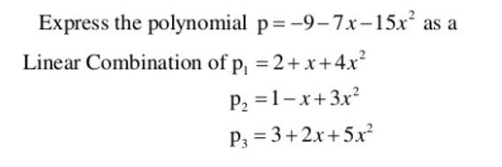

Example 4.
Example 5. Express the vector $u=\left(3, 9, 7\right)$as linear combination of vectors $u_{1}=\left(1, 4, −7\right)$, $u_{2}=\left(−2, 0, 6\right)$ and $u_{3}=\left(7, 1, 3\right)$.

Slide 6
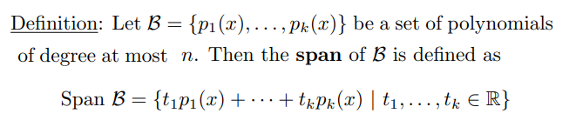
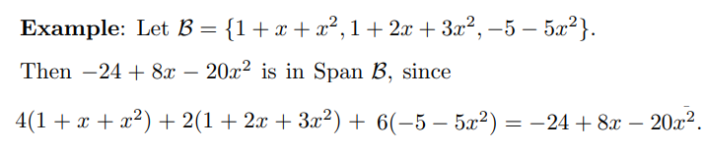
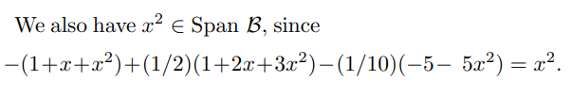
Span

Slide 7
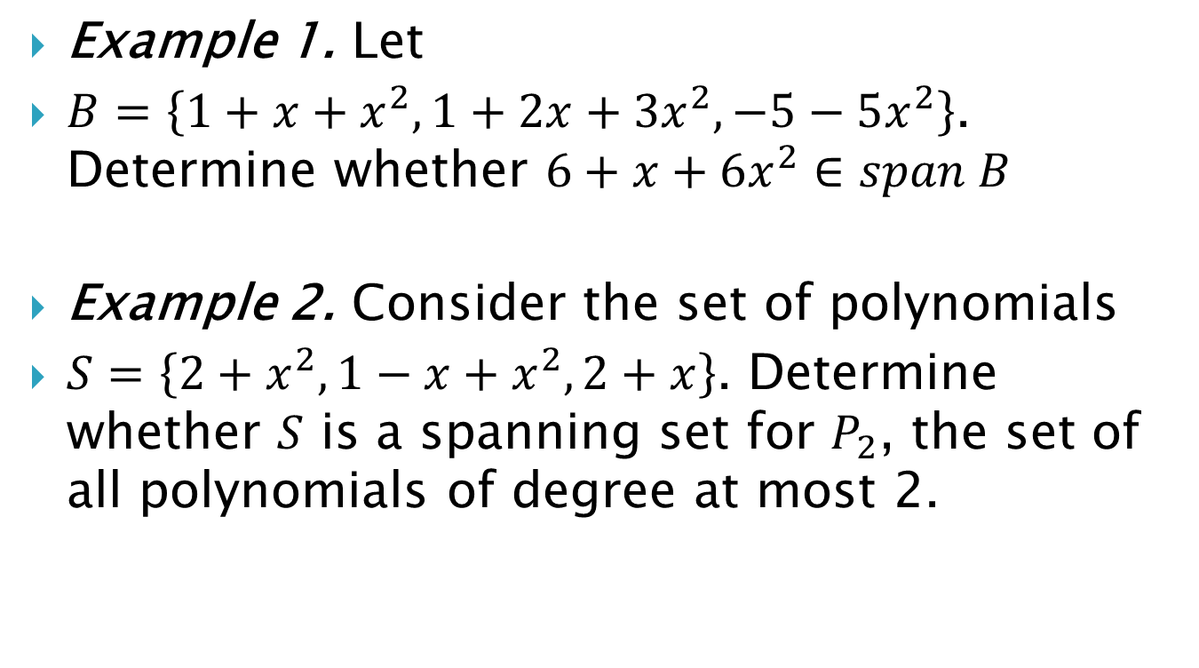
Example 1. Let
$B=\left\{1+x+x^{2}, 1+2x+3x^{2}, −5−5x^{2}\right\}$. Determine whether $6+x+6x^{2}∈span B$
Example 2. Consider the set of polynomials
$S=\left\{2+x^{2}, 1−x+x^{2}, 2+x\right\}$. Determine whether $S$ is a spanning set for $P_{2}$, the set of all polynomials of degree at most 2.

Slide 8
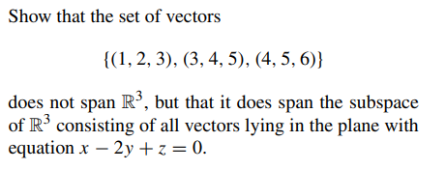

Example 3.
Example 4.

Slide 9
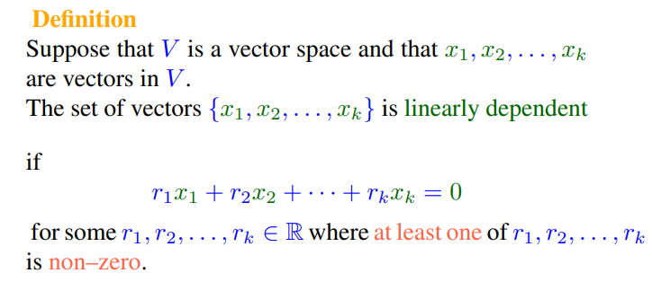
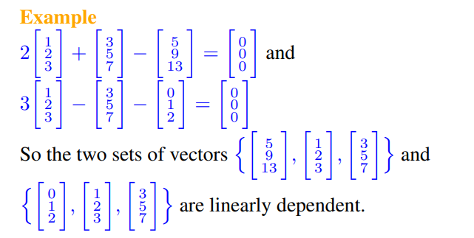

Slide 10
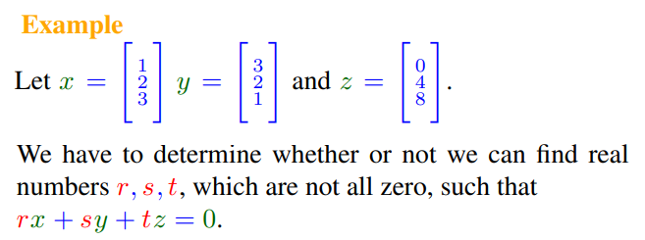
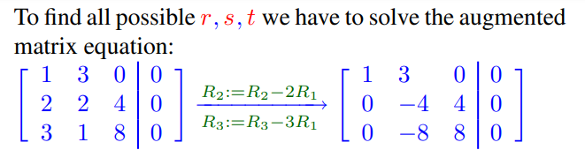

Slide 11
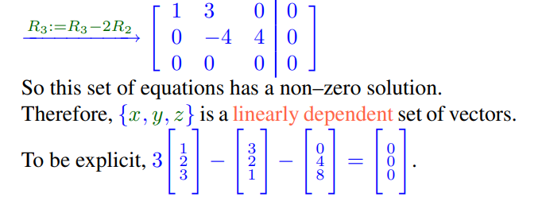

Slide 12
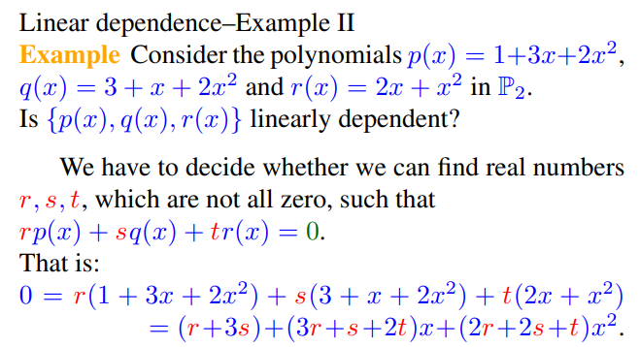
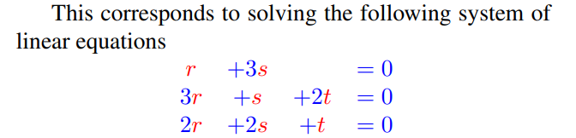

Slide 13
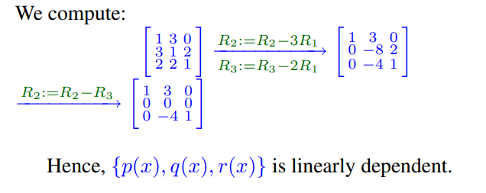

Slide 14
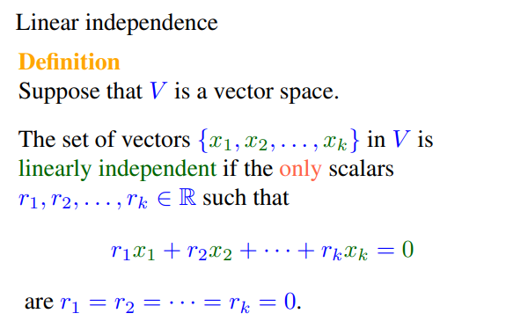
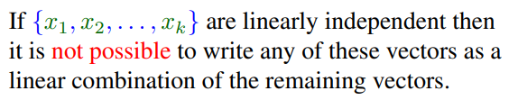

Slide 15
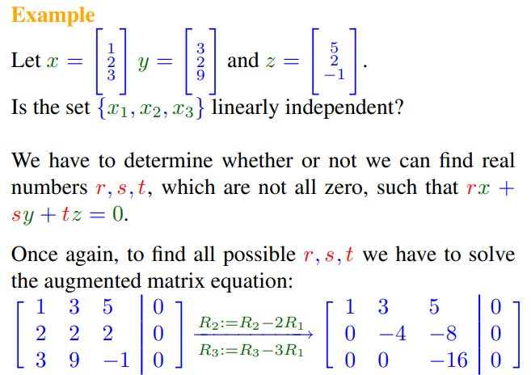

Slide 16
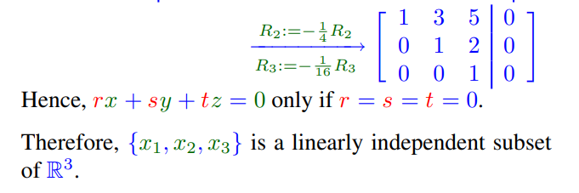

Slide 17
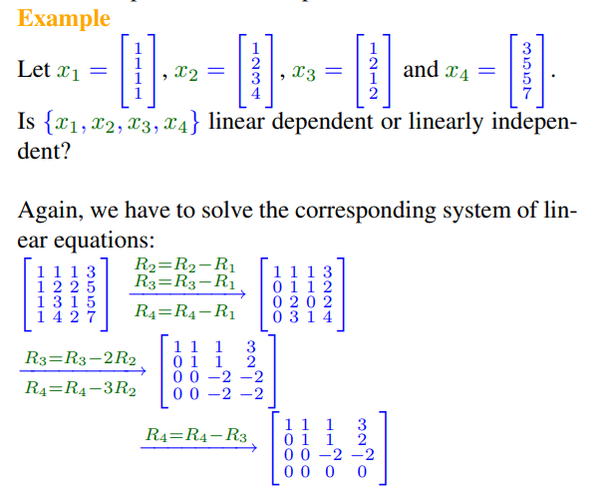


Slide 18
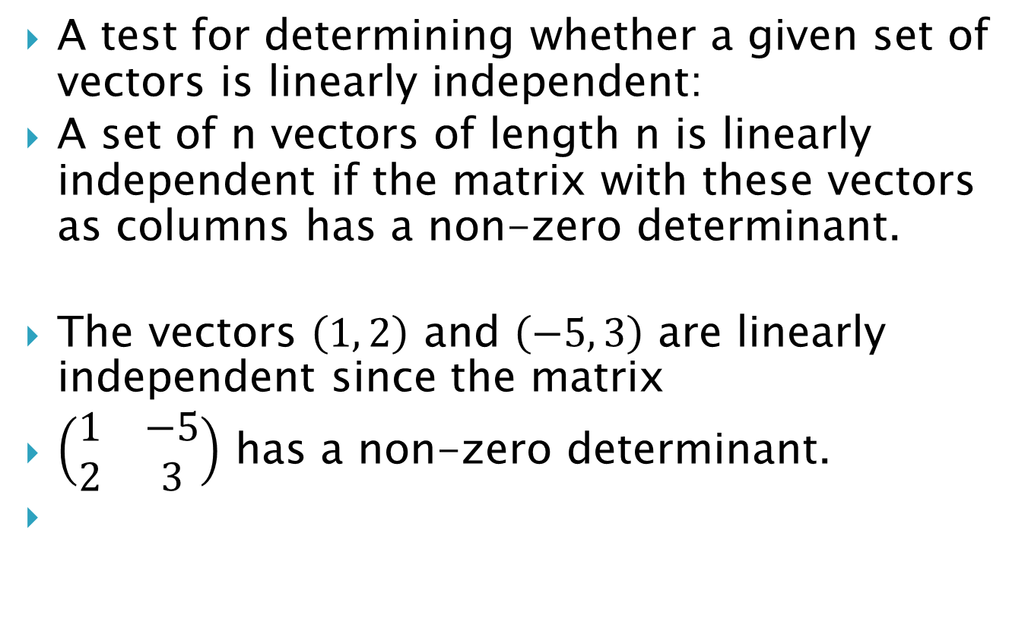
A test for determining whether a given set of vectors is linearly independent:
A set of n vectors of length n is linearly independent if the matrix with these vectors as columns has a non-zero determinant.
The vectors $\left(1, 2\right)$ and $\left(−5, 3\right)$ are linearly independent since the matrix
$\left(\begin{matrix}1 & −5 \\ 2 & 3\end{matrix}\right)$ has a non-zero determinant.

Slide 19


The vectors $u=\left(2, −1, 1\right)$, $v=\left(3, −4, −2\right)$ and $w=\left(5, −10, −8\right)$ are dependent since the determinant

